Slide 1
Discrete Mathematics
South China University of Technology

Slide 2
Chapter 1. Logic and Proof, Sets, and Function
Rules of Inference
Section 1.5

Slide 3
Contents
1
Rules of Inference
2
Valid Argument, Resolution and Fallacies
3
Rules of Inference for Quantified Statement
4
Method of Proving Theorems
5
Exercise

Slide 4
Rules of Inference

Slide 5
Some Terminologies
Axioms公理 are the underlying assumptions about mathematical structures. 无需证明
Postulates假设前提 are hypotheses of the theorem to be proved.无需证明
A conjecture is a statement whose truth value is unknown. 等待证明.

Slide 6
Some Terminologies
A theorem is a statement that can be shown to be true.
A Lemma is a simple theorem used in the proof of other theorems.
A corollary is proposition that can be established directly from a theorem that has been proved.
以上都是真命题

Slide 7
Some Terminologies
A proof is that a sequence of statements that form an argument so that the theorem is true.
Fallacies are some forms of incorrect reasoning, which will help clarity what makes a correct proof.

Slide 8
Inference Rules - General Form
An Inference Rule is
A pattern that if we know that all premisses前提are true, then we can deduce that a conclusion is true.
premiss 1 premiss 2 … ∴ conclusion “∴” means “therefore”

Slide 9
Valid Arguments
An argument 论证 form is called valid if
[( p1 ∧ p2 ∧ … ∧ pn ) → q]=T,
which is denoted by
( p1 ∧ p2 ∧ … ∧ pn ) ⇒ q
Exmaple: (a→ b)=T, (c→ d)=F, then
a ⇒ b, c !⇒ d
Question: Zeng received A.M. Turing Award
⇒ zeng is American president ?

Slide 10
Valid Arguments
[P→Q]=T denoted by P ⇒ Q
[P↔Q]=T denoted by P ⇔ Q
?
?

Slide 11
Inference Rules
(1) 附加
(2) 化简
(3) 假言推理
(4) 拒取式
(5) 析取三段论
(6) 假言三段论

Slide 12
Inference Rules
(7) 等价三段论
(8) 构造性二难
(9) 破坏性二难
(A → B) ∧(C → D) ∧(¬B∨¬D) ⇒(¬A∨¬C)

Slide 13
Inference Rules
How to prove the Inference Rules ? for example, how to prove
(A → B) ∧(C → D) ∧(¬B∨¬D) ⇒(¬A∨¬C)
There are 3 different proofs.
Using truth table to show it .
Using equivalence rules to show it.
Prove it by cases.

Slide 14
Inference Rules
2. equivalence rules.
[(A → B) ∧(C → D) ∧(¬B∨¬D) →(¬A∨¬C)]
⇔¬ [(A → B) ∧(C → D) ∧(¬B∨¬D) ]
∨(¬A∨¬C)
¬ (A → B) ∨¬ (C → D) ∨
¬ (¬B∨¬D)∨¬A∨¬C
⇔¬ (¬A ∨ B) ∨¬ (¬C ∨ D) ∨(B ∧D )∨¬A∨¬C
⇔(A ∧ ¬B) ∨(C ∧¬ D) ∨(B ∧D ) ∨¬A∨¬C

Slide 15
Inference Rules
2. equivalence rules.
[(A → B) ∧(C → D) ∧(¬B∨¬D) →(¬A∨¬C)]
⇔(A ∧ ¬B) ∨(C ∧¬ D) ∨(B ∧D ) ∨¬A∨¬C
⇔ ¬B ∨¬A ∨(C ∧¬ D) ∨(B ∧D ) ∨¬C
⇔ ¬B ∨D∨ ¬A ∨ (C ∧¬ D) ∨¬C
⇔ ¬B ∨¬A ∨D∨ C ∨¬C
⇔T

Slide 16
Inference Rules
3. Proof by cases.
(A → B) ∧(C → D) ∧(¬B∨¬D) ⇒(¬A∨¬C)
3.1 Case (¬B)=T.
Prove (A → B) ∧(C → D) ∧ ¬B ⇒(¬A∨¬C)
3.2 Case (¬D)=T.
Prove (A → B) ∧(C → D) ∧ ¬D ⇒(¬A∨¬C)

Slide 17
Valid Argument, Resolution and Fallacies

Slide 18
Example 6
“It is sunny this afternoon” p
“it is colder than yesterday” q
“We will go swimming” r
“We will take a canoe独木舟trip” s
“We will be home by sunset日落” t
Hypotheses
¬p ∧ q r → p ¬r → s s→ t
Conclusion t

Slide 19
Argument
¬p ∧ q, r → p,
Step
1. ¬p ∧ q
2. ¬p
3. r → p
4. ¬r
5. ¬r → s
6. s
7. s→ t
8. t
¬r → s , s→ t
Reason
Hypothesis
Simplification using Step 1
Hypothesis
Modus tollens using 2-3
Hypothesis
Modus tollens using 4-5
Hypothesis
Modus tollens using 6-7

Slide 20
Example 7
“You send me an e-mail message” p
“I will finish writing the program” q
“I will go to sleep early” r
“I will wake up feeling refreshed” s
Hypotheses ：p → q ¬p → r r → s
Conclusion：¬q → s

Slide 21
Argument
p → q , ¬p → r,
Step
1. p → q
2. ¬q → ¬p
3. ¬p → r
4. ¬q → r
5. r → s
6. ¬q → s
r → s⇒ ¬q → s
Reason
Hypothesis
Contrapositive of Step 1
Hypothesis
Hypothetical syllogim using 2-3
Hypotheses
Hypothetical syllogim using 4-5

Slide 22
Example 8
“It is snowing” p
“Jasmine is skiing” q
“Bart is playing hockey曲棍球” r
Hypotheses ¬ p ∨ q p ∨ r
Conclusion r ∨ q
((¬ p ∨ q ) ∧ (p ∨ r )) → ( r ∨ q )
r ∨ q is the true conclusion implied by Hypotheses.

Slide 23
Example 9
Premises： ( p ∧ q ) ∨ r ， r → s
Conclusion： p ∨ s
(p ∧ q ) ∨ r
(p ∨ r) ∧ (q ∨ r)
p∨ r
r → s
¬ r ∨ s
( p ∨ r ) ∧ (¬ r ∨ s ) ⇒ p ∨ s

Slide 24
Example in Chinese
如果今天是星期一，则要进行英语或离散数学考试。如果英语老师有会，则不考英语。 今天是星期一并且英语老师有会, 所以进行离散数学考试。
解：
：今天是星期一，
：进行英语考试，
：进行离散数学考试，
：英语老师有会。
前提：
结论：

Slide 25
Example in Chinese
前提：
结论：
证明：
①
前提引入
②
前提引入
③
①②假言推理
④
前提引入
⑤
前提引入
⑥
④⑤假言推理
⑦
③⑥析取三段论

Slide 26
Example in Chinese
如果6是偶数，则2不能整除7；5不是素数，或者2整除7；5是素数。因此，6是奇数。
解：
：6是偶数，
：2整除7，
：5是素数。
前提：
结论：

Slide 27
Example in Chinese
前提：
结论：
证明：
①
前提引入
②
①置换规则
③
前提引入
④
②③假言推理
⑤
前提引入
⑥
④⑤拒取式

Slide 28
Formal Proof Example
Suppose we have the following premises: “It is not sunny and it is cold.” “We will swim only if it is sunny.” “If we do not swim, then we will canoe.” “If we canoe, then we will be home early.”
Given these premises, prove the theorem “We will be home early” using inference rules.

Slide 29
Formal Proof Example
“It is not sunny and it is cold.” “We will swim only if it is sunny.” “If we do not swim, then we will canoe.” “If we canoe, then we will be home early.”
Step 1: introduce symbols.
sunny = “It is sunny”; cold = “It is cold”; swim = “We will swim”;
canoe = “We will canoe”;
early = “We will be home early”.

Slide 30
Formal Proof Example
“It is not sunny and it is cold.” “We will swim only if it is sunny.” “If we do not swim, then we will canoe.” “If we canoe, then we will be home early.”
Step 2: symbolize problem.
The premises can be written as:
(1) ¬sunny ∧ cold
(2) swim → sunny (3) ¬swim → canoe
(4) canoe → early

Slide 31
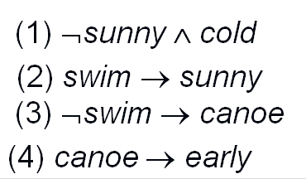
Proof Example cont.
Step Proved by
1. ¬sunny ∧ cold Premise #1.
2. ¬sunny Simplification of 1.
3. swim→sunny Premise #2.
4. ¬swim Modus Tollens on 2,3.
5. ¬swim→canoe Premise #3.
6. canoe Modus Ponens on 4,5.
7. canoe→early Premise #4.
8. early Modus Ponens on 6,7.

Slide 32
Resolution
Computer programs have been developed to automate the task of reasoning and proving theorem.
The resolution 消解 is used to for the programs as a rule of inference.
The is resolution based on the tautology
(( p ∨ q ) ∧ ( ¬ p ∨ r )) → ( q ∨ r )=T, ie,
(( p ∨ q ) ∧ ( ¬ p ∨ r )) ⇒ ( q ∨ r )

Slide 33
Resolution
(( p ∨ q ) ∧ ( ¬ p ∨ r )) ⇒ ( q ∨ r )
( q ∨ r ) is called the resolvent.消解式
Let r = q ( p ∨ q ) ∧ ( ¬ p ∨ q ) ⇒ q
Let r = F ( p ∨ q ) ∧ ( ¬ p ) ⇒ q
which is the tautology on which the rule of disjunctive syllogism 析取三段论is based.

Slide 34
Fallacies
Fallacy 1. (( p → q ) ∧ q ) ⇒ p
Fallacy 2 : (( p → q ) ∧ ¬ p )⇒ ¬ q
Fallacy 1 is called the fallacy of affirming the conclusion.肯定结论谬论
Fact 1. (( p → q ) ∧ q ) !⇒ p
Fact 2 : (( p → q ) ∧ ¬ p )!⇒ ¬ q

Slide 35
Fallacies
Fact 1. (( p → q ) ∧ q ) !⇒ p
原因1: 引发q的原因有很多;
原因 2: p,q之间其实无因果关系.
p → q : if p, then q.
causal relationship. Eg, If Trump eat much meat, then he is fat.
non-causal relationship. Eg, p: Z earn the Turing award, q: you are millionaires.

Slide 36
Method of Proving Theorems

Slide 37
Other proof methods for implications
For proving p ⇒ q, we have:
Direct proof: Assume p=T, and prove q=T.
Note that we do not consider p=F
Indirect proof: Assume ¬q, and prove ¬p.

Slide 38
(1) Please prove
Proof:
¬(r ∨ s) 反证法, 引入前提
¬r ∧ ¬ s
¬r
¬ s
p→r
¬p
p ∨ q
q
q→s
s
11. F

Slide 39
Other proof methods for implications
Proof by cases
To prove ( p1 ∨ p2 ) ⇒ q, we only need to prove:
p1 ⇒ q and p2 ⇒ q
Why ?
[ ( p1 ∨ p2 ) → q ] ⇔ [( p1 → q ) ∧ ( p2 → q ) ]

Slide 40
Proof by Cases
To prove ( p1 ∨ p2 ∨… ∨ pn ) ⇒ q, we only need to prove:
pi ⇒ q
for each i=1,…,n.

Slide 41
Proof by Equivalence
To prove ( p ⇔ q ), we can prove
( p ⇒ q ) ∧ ( q ⇒ p )
why?
( p ↔ q ) ⇔ [ ( p → q ) ∧ ( q → p ) ]

Slide 42
Proof by Equivalence
To prove p1 ⇔ pn , we can prove
( p1 ⇒ p2 ) ∧ ( p2 ⇒ p3 ) ∧…∧ ( pn ⇒ p1 )

Slide 43
many examples can be seen in the textbook!

Slide 44
命题证明总结1
请问以上2个题目有什么不同吗?
答: 没有不同
启发: 将题目1转化成题目2

Slide 46
Exercise in Chinese
(3) 如果乙不参加篮球赛，那么甲就不参加；
如果乙参加篮球赛，那么甲和丙就参加。
因此，如果甲参加篮球赛，那么丙就参加。
解：
：乙参加篮球赛，
：甲参加篮球赛，
：丙参加篮球赛。
前提：
结论：

Slide 47
证明:
q
¬p → ¬q
p
p→ (q ∧r)
q ∧r
r

Slide 48
Exercise in Chinese
前提：
结论：
证明：
①
前提引入
②
①置换规则
③
前提引入
④
②③假言三段论
⑤
④置换规则

Slide 49
命题证明总结2
请问以上题目有什么不同吗?
答: 没有不同

Slide 50
命题证明总结3
利用推理规则进行形式化证明.(重点)
利用真值表证明复合命题(p→q)=T.(简单粗暴)
利用推理和等价规则证明复合命题(p→q)=T. (繁琐)

Slide 51
命题证明总结4
利用推理公式进行形式化证明.(重点)
p⇒q
q ⇒p
利用真值表证明复合命题(p↔q)=T.(简单粗暴)
利用公式证明复合命题(p↔q)=T.

Slide 53
Rules of Inference for Quantified Statement

Slide 54
All Inference Rules for Quantifiers
∀x P(x) ∴P(o) (substitute any object o)
P(g) (for g an arbitrary element) ∴∀x P(x)
∃x P(x) ∴P(c) (substitute a new constant c)
P(o) (for any object o) ∴∃x P(x)
Universal instantiation
Universal generalization
Existential instantiation
Existential generalization

Slide 55
Example 12
D(x) denotes “x is in this discrete mathematic class”
C(x) denotes “x has taken a course in Software Engineer”
The premises are ∀x (D(x) → C(x)) and D(Marla)
∀x (D(x) → C(x)) Premise
D(Marla) → C(Marla) Universal instantiation
D(Marla) Premise
C(Marla) Modus Ponens from #2 and #3

Slide 56
Example 13
C(x) denotes “x is in this class”
B(x) denotes “x has read the book”
P(x) denotes “x passed the first exam”
Please prove
∃ x (C(x) ∧ ¬ B(x)),
∀ x (C(x) → P(x))
⇒ ∃ x (P(x) ∧ ¬ B(x))

Slide 57
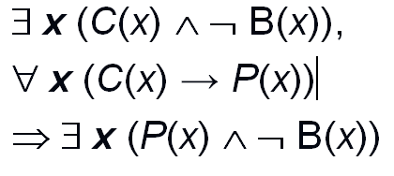
1. ∀ x (C(x) → P(x))
2. C(a) → P(a)
3. ∃ x (C(x) ∧ ¬ B(x))
4. C(a) ∧ ¬ B(a)
5. C(a)
6. P(a)
7. ¬ B(a)
8. P(a) ∧ ¬ B(a)
9. ∃ x (P(x) ∧ ¬ B(x))
Warning:
this proof is wrong

Slide 58
1. ∃ x (C(x) ∧ ¬ B(x)) Premise
2. C(a) ∧ ¬ B(a) Existential instantiation from 1
3. C(a) Simplification from 2
4. ∀ x (C(x) → P(x)) Premise
5. C(a) → P(a) Universal instantiation from 4
6. P(a) Modus pones from 3 and 5
7. ¬ B(a) Simplification from 2
8. P(a) ∧ ¬ B(a) Conjunction from 6 and 7
9. ∃ x (P(x) ∧ ¬ B(x)) Existential generalization from 8

Slide 59
谓词与命题的关系
例子: C(x) denotes “x is in this class”, P(x) denotes “x passed the first exam”.
∀ x (C(x) → P(x)) ?
是命题
C(图灵) → P(图灵) ?
是命题
C(x) → P(x)?
不是命题, 因为x是自由的.

Slide 60
谓词与命题的关系
谓词包含命题. 因为命题可以看作是没有变量的谓词.
∀ x (C(x) → P(x))
C(图灵) → P(图灵)
C(x) → P(x)
以上都是谓词逻辑, 但是只有1和2是命题.

Slide 61
谓词证明总结
既然实例化后的谓词就是命题公式, 那么就可以使用命题公式的推理规则和等价规则证明. 例如:
3. C(a) Simplification from 2
4. ∀ x (C(x) → P(x)) Premise
5. C(a) → P(a) Universal instantiation from 4
6. P(a)

Slide 62
教训
一般先实例化 ∃, 后实例化∀

Slide 63
批判性思考(挑剔性思考)
“你说甲生疮。甲是中国人，你就是说中国人生疮了。既然中国人生疮，你是中国人，就是你也生疮了。你既然也生疮，你就和甲一样。而你只说甲生疮，则竟无自 知之明，你的话还有什么价值？倘你没有生疮，是说诳也。卖国贼是说诳的，所以你是卖国贼。我骂卖国贼，所以我是爱国者。爱国者的话是最有价值的，所以我的 话是不错的，我的话既然不错，你就是卖国贼无疑了！”

Slide 64
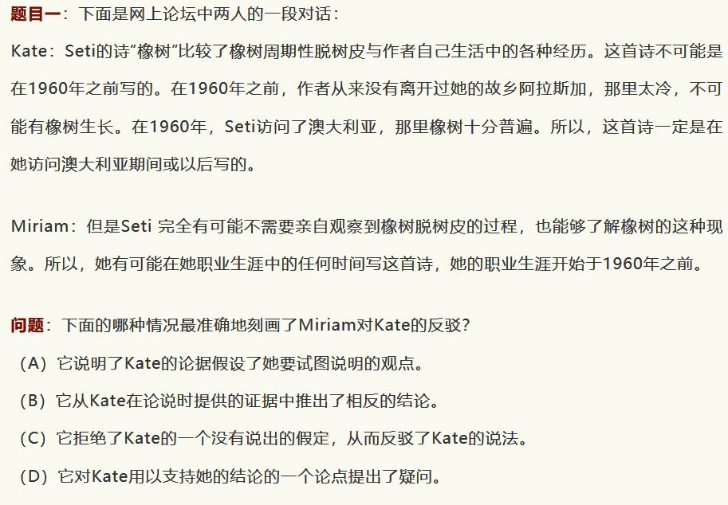

Slide 65
批判性思考(挑剔性思考)
不使用物理知识, 只使用数学, 分析”重量大的物体下落速度快”.
如果努力学习, 那么你就会及格. 既然你及格了, 说明你学习努力.

Slide 66
逻辑学导论(Introduction to Logic), [美] 欧文·M·柯匹 / [美] 卡尔·科恩, 中国人民大学出版社
https://book.douban.com/subject/2060491/

Slide 67
P69
7 c, d;
14
15

Slide 68
End of the Section 1.5
68

